Slide 1
REAL ESTATE
MARKETING PLAN
Here is where your presentation begins

Slide 2
CONTENTS OF THIS TEMPLATE
Here’s what you’ll find in this Slidesgo template:
A slide structure based on a marketing plan, which you can easily adapt to your needs. For more info on how to edit the template, please visit Slidesgo School or read our FAQs.
An assortment of illustrations to use in the presentation can be found in the alternative resources slide.
A thanks slide, which you must keep so that proper credits for our design are given.
A resources slide, where you’ll find links to all the elements used in the template.
Instructions for use.
Final slides with:
The fonts and colors used in the template.
More infographic resources, whose size and color can be edited.
Sets of customizable icons of the following themes: general, business, avatar, creative process, education, help & support, medical, nature, performing arts, SEO & marketing, and teamwork.

Slide 3
TABLE OF CONTENTS
01
02
03
ABOUT US
MARKET ANALYSIS
GOALS & STRATEGY
04
05
06
CONTENT PLAN
BUDGET
KPI OVERVIEW
Here you could describe the topic of the section
Here you could describe the topic of the section
Here you could describe the topic of the section
Here you could describe the topic of the section
Here you could describe the topic of the section
Here you could describe the topic of the section

Slide 4
OUR COMPANY
Mercury is the closest planet to the Sun and the smallest one in the Solar System—it’s only a bit larger than our Moon. The planet’s name has nothing to do with the liquid metal, since it was named after the Roman messenger god, Mercury
MYHOME
REAL ESTATE

Slide 5
OUR EVOLUTION
2005
2008
2010
Jupiter is the biggest planet in our Solar System
Venus has a beautiful name, but it’s terribly hot
Despite being red, Mars is a cold place, not hot

Slide 6
OUR EVOLUTION
2012
2018
Mercury is the closest planet to the Sun
Neptune is the farthest planet from the Sun
And still going strong!

Slide 7
WHAT SETS US APART?
POSSIBILITY OF SKYSCRAPERS OR HOUSES
A NEIGHBORHOOD
ADAPTED TO YOUR NEEDS
IN THE OUTSKIRTS OR DOWNTOWN
Neptune is the farthest planet from the Sun and the fourth-largest in our Solar System.
Mercury is the closest planet to the Sun and also the smallest one in our Solar System
Venus has a beautiful name and is the second planet from the Sun. It’s terribly hot

Slide 8
GUIDING PRINCIPLES
SMART
HOUSES
Neptune is the farthest planet from the Sun
PERSONALIZED
SEARCHING
Jupiter is a gas giant and the biggest planet in our Solar System
MOBILE
PURCHASE
Venus has a beautiful name, but it’s even hotter than Mercury
GOOD
LOCATION
Mercury is the smallest planet in our Solar System
SECURE
PURCHASE
Despite being red, Mars is a cold place, not hot

Slide 9
—Someone famous
“This is a quote. Words full of wisdom that someone important said and can make the reader get inspired.”

Slide 10
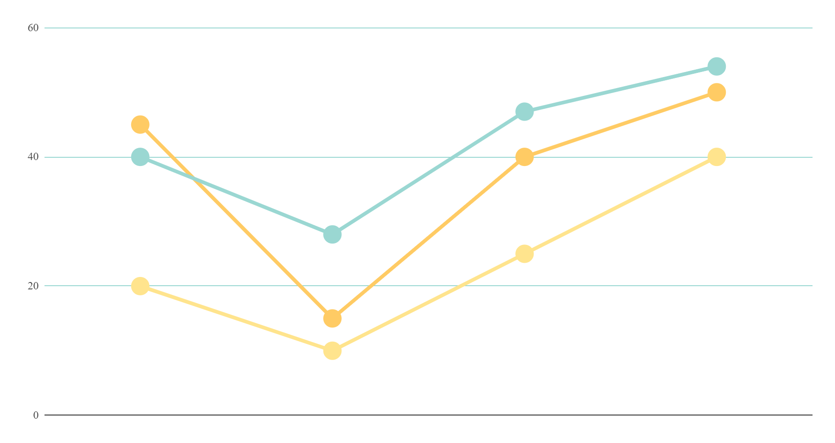
MARKET SHARE: SALES GROWTH
MARS
Despite being red, Mars is a cold place, not hot. It’s full of iron oxide dust
SATURN
It’s a gas giant, composed mostly of hydrogen and helium
VENUS
Venus has a beautiful name, but it’s terribly hot, even hotter than Mercury
If you want to modify this graph, click on it, follow the link, change the data and replace it

Slide 11
BUYER PERSONA PROFILE
INTERESTS
Ecology
Animals
Social causes
INFLUENCES
Social media
Blogs
Trusted people
CAREER
Teachers
Doctors
Engineers
FREE TIME
Photography
Concerts
Traveling

Slide 12
BUYER JOURNEY
AWARENESS
Jupiter is a gas giant and the biggest planet in our Solar System
CONSIDERATION
Mercury is the closest planet to the Sun and the smallest one in the Solar System
DECISION
Venus has a beautiful name and is the second planet from the Sun

Slide 13
SALES FUNNEL
AWARENESS
Venus has a beautiful name, but it’s terribly hot
INTEREST
Jupiter is the biggest planet in our Solar System
DECISION
Saturn is composed mostly of hydrogen and helium
PURCHASE
Despite being red, Mars is a cold place, not hot

Slide 14
COMPETITOR ANALYSIS
#4
#3
#2
MERCURY
Mercury is the closest planet to the Sun
#1
MARS
Despite being red, Mars is a cold place
NEPTUNE
Neptune is the farthest planet from the Sun
JUPITER
It’s the biggest planet in our Solar System

Slide 15
SWOT ANALYSIS
STRENGTHS
WEAKNESSES
Despite being red, Mars is a cold place, not hot. It’s full of iron oxide dust
Jupiter is a gas giant and the biggest planet in our Solar System
OPPORTUNITIES
THREATS
Saturn is a gas giant, composed mostly of hydrogen and helium
Venus has a beautiful name and is the second planet from the Sun

Slide 16
GOALS
SHORT TERM
LONG TERM
GOAL 1
Jupiter is the biggest planet in our Solar System
GOAL 3
Despite being red, Mars is a cold place, not hot
GOAL 2
Saturn is composed mostly of hydrogen and helium
GOAL 4
Mercury is the closest planet to the Sun

Slide 17
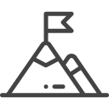
STRATEGY
MERCURY
Mercury is the smallest planet in our Solar System
01
KEY ACTION 1
Neptune is the farthest planet from the Sun
JUPITER
It’s a gas giant and the biggest planet in our Solar System
02
GOAL
The Sun is the star at the center of the Solar System
SATURN
It’s a gas giant, composed mostly of hydrogen and helium
03
KEY ACTION 2
Venus has a beautiful name, but it’s very hot
MARS
Despite being red, Mars is a cold place, not hot
04

Slide 18
KEY ACTION ITEMS
 | FIRST QUARTER | SECOND QUARTER | THIRD QUARTER
KEY ACTION 1 | Here you can describe your items for the quarter | Here you can describe your items for the quarter | Here you can describe your items for the quarter
KEY ACTION 2 | Here you can describe your items for the quarter | Here you can describe your items for the quarter | Here you can describe your items for the quarter
KEY ACTION 3 | Here you can describe your items for the quarter | Here you can describe your items for the quarter | Here you can describe your items for the quarter
KEY ACTION 4 | Here you can describe your items for the quarter | Here you can describe your items for the quarter | Here you can describe your items for the quarter

Slide 19
TIMELINE
DAY 1
Jupiter is the biggest planet in our Solar System
DAY 2
Despite being red, Mars is a cold place, not hot
DAY 3
Venus has a beautiful name, but it’s terribly hot
DAY 4
DAY 5
Mercury is the closest planet to the Sun
Neptune is the farthest planet from the Sun

Slide 20
BUDGET
20%
Graphic design
5%
Influencers
15%
Product placement
$20,000,000
Total plan budget
60%
Online ads

Slide 21
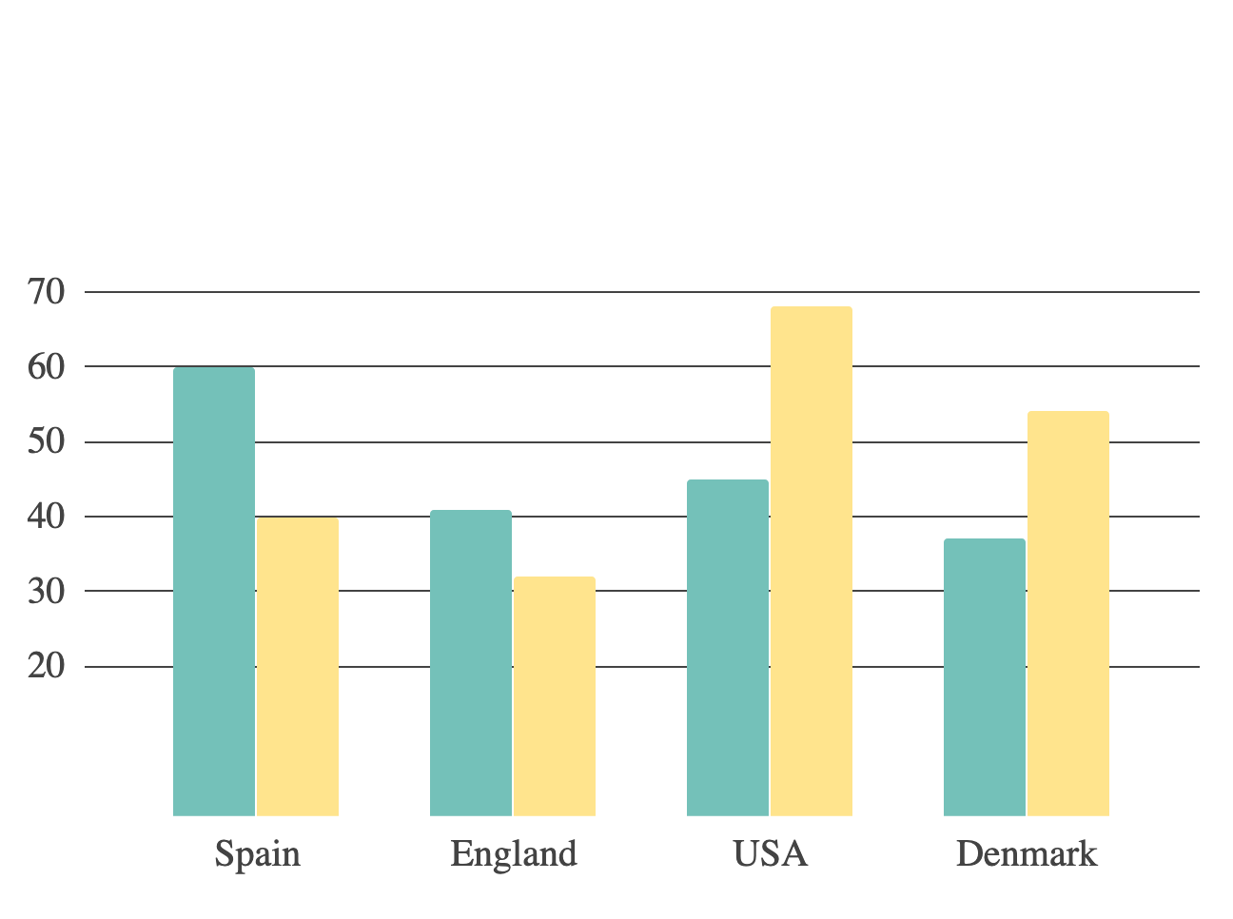
KPI OVERVIEW
DEMOGRAPHIC RATE
2000-2010
2010-2020
SALES RATE
BRANDING
ENGAGEMENT
CONVERSIONS
LOYALTY
NEW CLIENTS

Slide 22
THANKS
Does anyone have any questions?
addyouremail@freepik.com
+91 620 421 838
yourcompany.com

Slide 23
ALTERNATIVE
ILLUSTRATIONS

Slide 24
RESOURCES
Did you like the resources on this template? Get them for free at our other websites.
VECTORS
Flat nature landing page template
Real estate logotypes set
Modern office building collection with flat design
Nature decorative landscape flat design
Woman enjoying her free time
Teamwork concept for landing page
Infographic timeline concept
Set of different houses
House for rent concept background
House for rent concept background
Eco village using renewable energies
Flat background with a house for rent
Family outdoors
Set of young people reading
Colorful people doing different actions
Christmas town background in flat style
Set of people enjoying their free time
Creative flat christmas town background

Slide 25
...and our sets of editable icons
You can resize these icons, keeping the quality.
You can change the stroke and fill color; just select the icon and click on the paint bucket/pen.
In Google Slides, you can also use Flaticon’s extension, allowing you to customize and add even more icons.

